Slide 1
Azure Web Apps
[ Instructor Name ]
[ Instructor E-mail ]

Slide 2





Azure App Service Family
Web Apps
Web apps that scale with your business
Mobile Apps
Build mobile apps for any device
Logic Apps
Automate business processes across SaaS and on-premises
API Apps
Build and consume APIs in the cloud

Slide 3
Azure Web Apps
Support a variety of languages and platforms
.NET, Java, Node.js, PHP, Python, and more
Support scaling (manual or auto) and load balancing
Support slots for staged deployments and A/B testing
Support continuous integration
Familiar and Fast
Leverage existing skills, plus languages, frameworks, and tools you're familiar with
Enterprise Grade
ISO-, SOC2-, and PCO-compliant with enterprise-level SLAs
Global Scale
Scale up and down as needed, manually or automatically

Slide 4
Scaling - Cloud Computing Patterns
Inactivity
Period
Compute
Compute
t
t
On and Off
Unpredictable Bursts
On & off workloads (e.g. batch job)
Over provisioned capacity is wasted
Time to market can be cumbersome
Unexpected/unplanned peak in demand
Sudden spike impacts performance
Can’t over provision for extreme cases
Compute
Compute
t
t
Growing Fast
Predictable Bursts
Successful services needs to grow/scale
Keeping up w/ growth is big IT challenge
Cannot provision hardware fast enough
Services with micro seasonality trends
Peaks due to periodic increased demand
IT complexity and wasted capacity

Slide 5
Scaling Up vs. Scaling Out
Scale Up
Scale Out
Vary the VM size
Vary the VM count
1 Core w/ 1.75 GB RAM 2 Cores w/ 3.5 GB RAM 4 Cores w/ 7 GB RAM
Max 3* instances Max 10 instances Max 20/50** instances
Notes:
In App Services, scale up is choice between B/S/P 1-3, where 1 = 1 Core, 1/75 GB RAM, 2 = 2 Core, 3.5 GB RAM, 3 = 4 Core, 7 GB RAM
Can also scale up/down between tiers (B/S/P) – affects local HDD storage(10/50/250 GB), as well as cap on number of instances (3/10/50)
* For 3 instances on Basic, only manual scaling is supported
** For Premium Tier, there is a max of 20 if not using ASE’s, and 50 if using ASE’s

Slide 6
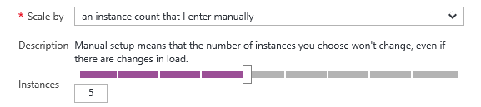
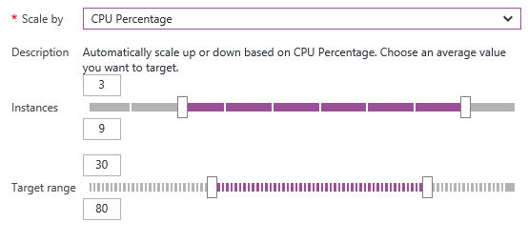
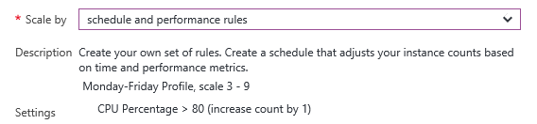
Manual Scaling vs. Auto-Scaling
Manual – Scale via portal or scripts
Auto – CPU Percentage
Auto – Schedule & Performance Rules

Slide 7

Web App
Notes:
Illustration – Do we use these MSFT-made illustrations, or come up with our own (perhaps 2D/flat/simple instead of 3D/fancy)

Slide 8
Web App

Slide 9
Web App

Slide 10
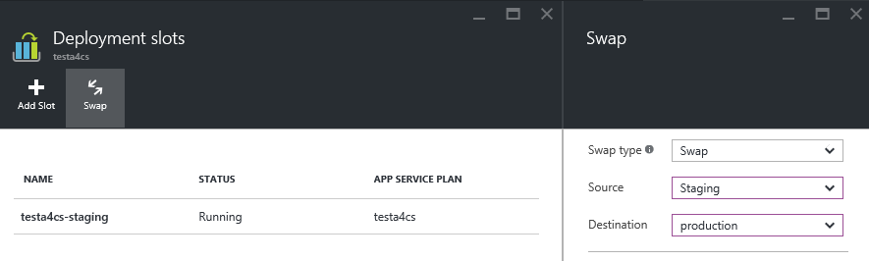
Deployment Slots
Use a Deploy-Confirm-Promote workflow
Promote via “swap” through Azure portal
http://sitename-slotname.azurewebsites.net

Slide 11
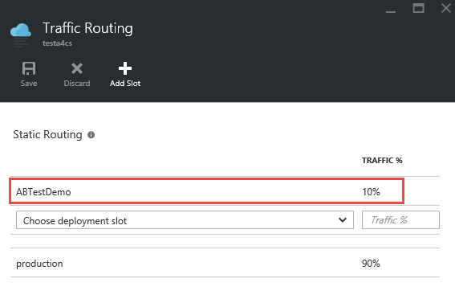
A/B Testing
Test changes by routing requests to different deployment slots
Use Traffic Routing to direct % of traffic to alternate slots

Slide 12






Continuous Integration
Web apps can be deployed manually via FTP or WebDeploy
Automate deployment using 3rd party source-control providers
Can also use a local Git repository
Git
Visual Studio Team Services
CodePlex
GitHub
BitBucket
DropBox

Slide 13


Continuous Integration + Deployment Slots
Production
Developer commits code
Automated process builds/compiles and deploys to staging slot
Automated and other tests validate content on staging slot
staging-slot content promoted to production
End users see updated site
Source Control
Staging
Test

Slide 14
App Service Plans
Billing and provisioning for App Service resources
 | Free | Shared | Basic | Standard | Premium
# of Apps | 10 | 100 | Unlimited | Unlimited | Unlimited
Shared Disk Space | 1 GB | 1 GB | 10 GB | 50 GB | 500 GB
Maximum Instances |  |  | Up to 3 | Up to 10 | Up to 50
Autoscale |  |  |  | X | X
Staging Environments |  |  |  | 5 | 20
Custom Domains |  | X | X | X | X
SLA |  |  | 99.95%

Slide 15
Hands-On Lab
Azure Web Apps HOL.html

